Slide 1

HI5030 Business Systems Analysis and Design
Tutorial Week 03
Outline
2018
Tutorial Week 3
Step-by-Step Instructions for the Online Quiz
08

Slide 2
HI5030 Business Systems Analysis and Design
Tutorial Week 03
Device Requirements:
Use an up-to-date, reliable computer or laptop.
The quiz will not work on any mobile device.
Ensure your device is using a supported browser such as Chrome or Firefox. Do not use Safari, Microsoft Edge, or the Blackboard mobile app.
Install all necessary updates on your device before starting the quiz.
Quiz Environment:
Make sure you have a stable internet connection.
Prepare a quiet environment where you can focus without interruptions.
Taking the Quiz
Access the Quiz:
Go to the Quiz Links folder on the Online Quizzes Information page. This folder contains submission links for each quiz and is only visible during the periods listed.
Reading Instructions:
Carefully read the instructions for each quiz before starting. Each quiz must be taken on campus during class time.
08

Slide 3
HI5030 Business Systems Analysis and Design
Tutorial Week 03
3. Starting the Quiz:
Click the quiz link to access the quiz.
Once ready, click "Begin" to start the quiz. Remember, once you click "Begin," you have 30 minutes to complete the quiz.
4. During the Quiz:
The quiz must be taken on one device only with one browser and tab open.
You can save and resume the quiz at any point during the 30 minutes, but the timer continues to run if you leave the quiz.
Pay particular attention to each question as you cannot go back to change your answers once you progress through the quiz.
If you encounter an error message, take a screenshot and email it to the Blackboard Helpdesk within the quiz availability time. Include your student number and unit code in the subject line.
5. Completing the Quiz:
Once you have answered all questions, click ‘Save & Submit’ to finish the quiz.
Ensure you complete the quiz within the available time. If time runs out, your answers will be automatically saved.
All submissions are considered final. You cannot re-commence the quiz if you submit before completing it.
08

Slide 4
HI5030 Business Systems Analysis and Design
Tutorial Week 03
Restrictions and Policies
Prohibited Actions:
Do not attempt the quiz using a VPN or an IP address from a different country or state as this breaches the Holmes Institute’s Student Academic Conduct and Integrity Policy.
Do not take the quiz on any mobile device.
Do not use more than one device, browser, or tab at a time to access the quiz.
You cannot re-commence the quiz if you submit before completing it.
Technical Support:
For any technical issues, contact the Blackboard Helpdesk. Do not contact Student Services or your Unit Coordinator for technical support.
08
By following these steps, you can ensure a smooth and successful quiz-taking experience. Good luck!

Slide 5
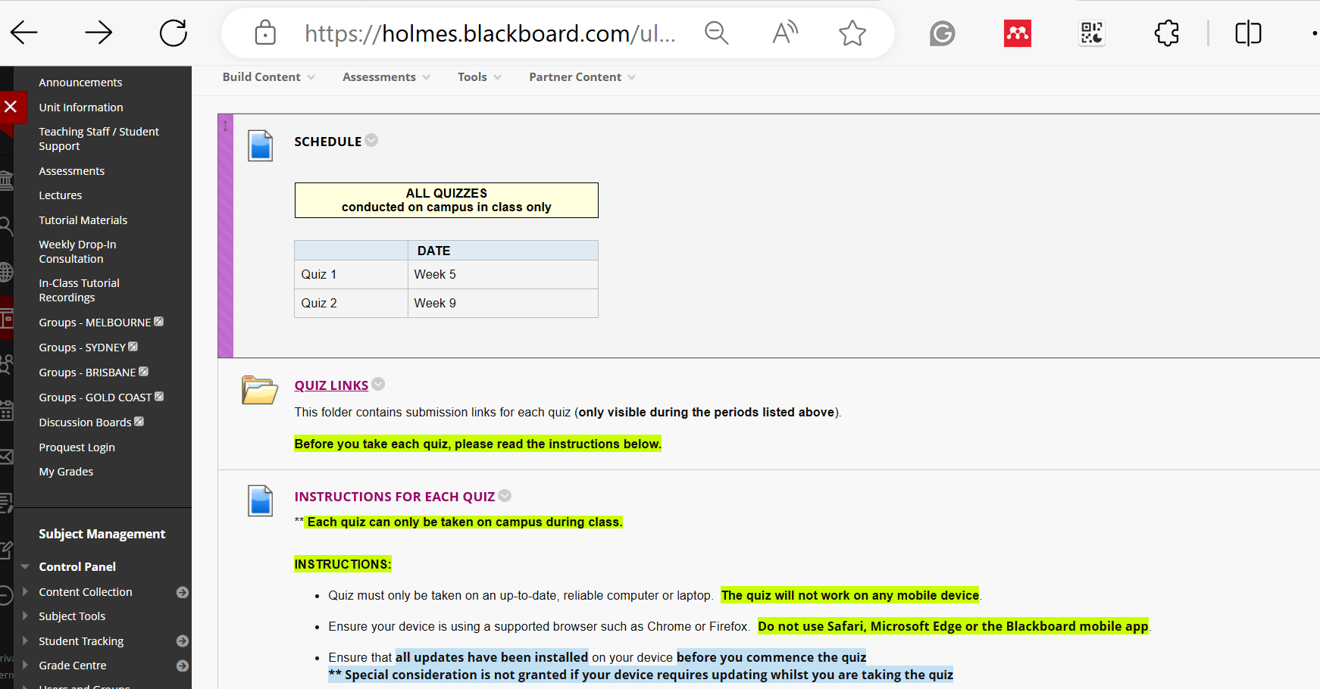
HI5030 Business Systems Analysis and Design
Tutorial Week 03
08

Slide 6
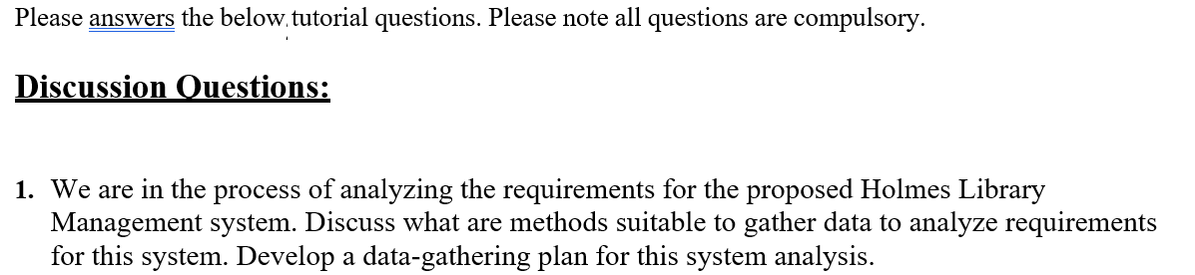
HI5030 Business Systems Analysis and Design
Tutorial Week 03
Question 1: Methods to Gather Data for Holmes Library Management System
Interviews:
Purpose: To gather detailed insights from stakeholders.
Plan: Interview librarians, staff, and students to understand their requirements and pain points.
Surveys/Questionnaires:
Purpose: To gather data from a larger audience quickly.
Plan: Distribute surveys to library users to collect data on their needs and suggestions.
Document Analysis:
Purpose: To review existing documents to understand current processes.
Plan: Analyze existing library records, transaction logs, and feedback forms.

Slide 7
HI5030 Business Systems Analysis and Design
Tutorial Week 03
4. Observation:
Purpose: To observe the current system in action.
Plan: Observe library operations to identify inefficiencies and user behavior.
5. Workshops:
Purpose: To gather ideas and feedback in a collaborative setting.
Plan: Conduct workshops with library staff and students to brainstorm and discuss requirements.

Slide 8
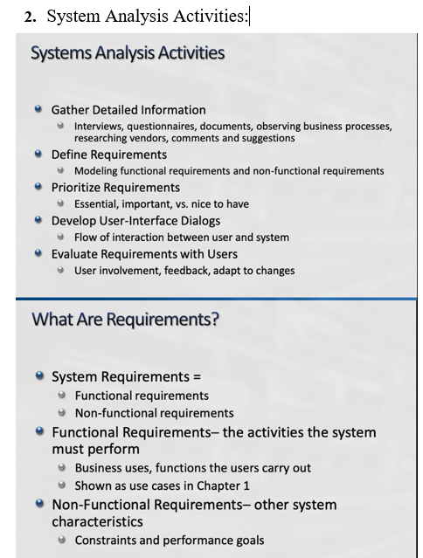
HI5030 Business Systems Analysis and Design
Tutorial Week 03

Slide 9
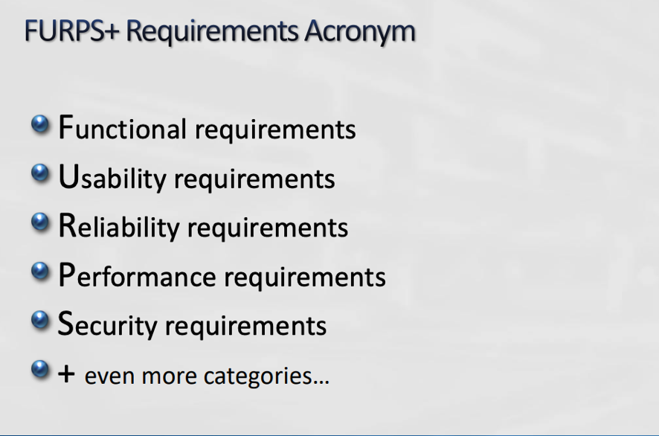
HI5030 Business Systems Analysis and Design
Tutorial Week 03
Question 2: Analyze the Format of Requirement Specification Documents
Link Analysis:
Review the provided links to understand the format and structure of requirement specification documents.
Identify common sections such as Introduction, System Overview, Functional Requirements, Non-functional Requirements, Use Cases, and Appendices.

Slide 10
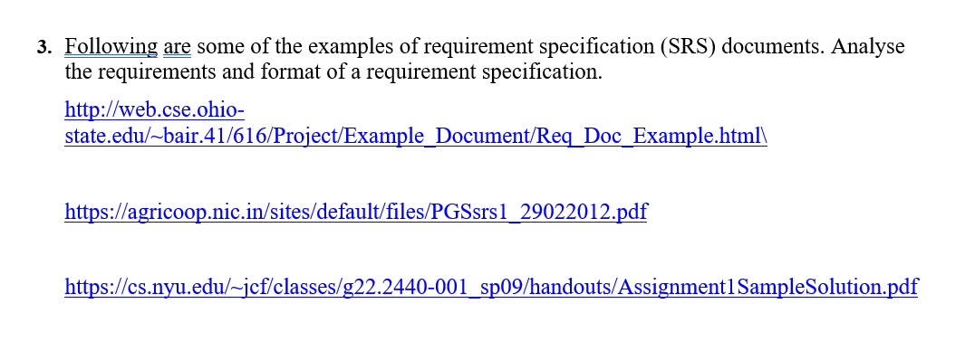
HI5030 Business Systems Analysis and Design
Tutorial Week 03
Question 3: Develop an Introductory Requirement Specification for Holmes Library Management System
Introduction:
Purpose: Outline the scope and objectives of the system.
Scope: Describe the functionalities and services the system will provide.
System Overview:
Describe the system architecture and major components.

Slide 11
HI5030 Business Systems Analysis and Design
Tutorial Week 03
3. Functional Requirements (based on FURPS+):
Functionality: List the core functions the system must perform (e.g., book borrowing, returning, catalog management).
Usability: Describe the user interface requirements.
Reliability: Define the expected uptime and error handling.
Performance: Specify performance metrics like response time.
Supportability: Mention requirements for maintenance and updates.
+ (Extra): Include security, interoperability, and legal requirements.

Slide 12
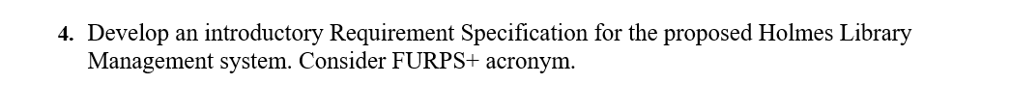
HI5030 Business Systems Analysis and Design
Tutorial Week 03
Question 4: List Functional and Non-functional Requirements for the WBS Case Study
Functional Requirements:
Book Management: Ability to add, update, and remove books.
Inventory Management: Track stock levels and generate reports.
Order Management: Handle special orders and regular orders.
User Management: Manage customer and staff profiles.
Non-functional Requirements:
Performance: System should handle concurrent users efficiently.
Reliability: Ensure high availability and quick recovery from failures.
Usability: User-friendly interface for staff and customers.
Security: Secure access with authentication and authorization.

Slide 13
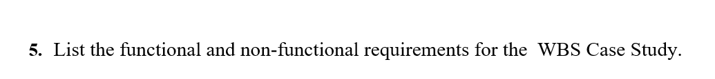
HI5030 Business Systems Analysis and Design
Tutorial Week 03
Question 5: User Stories and Acceptance Criteria for WBS Case Study and Librarian
User Story 1 for WBS Case Study:
Story: As a student, I want to order a textbook so that I can have it available for my course.
Acceptance Criteria:
Display available textbooks upon search.
Allow placing special orders if the book is not in stock.
Send confirmation email after order is placed.
User Story 2 for WBS Case Study:
Story: As a purchasing manager, I want to generate a stock report so that I can make informed purchasing decisions.
Acceptance Criteria:
Display current stock levels.
Show sales data for the past month.
Provide export option for the report.

Slide 14
HI5030 Business Systems Analysis and Design
Tutorial Week 03
3. User Story 1 for Librarian:
Story: As a librarian, I want to check the availability of a book so that I can assist a patron.
Acceptance Criteria:
Search by title, author, or ISBN.
Display current availability status.
Show location of the book in the library.
4. User Story 2 for Librarian:
Story: As a librarian, I want to manage overdue books so that I can ensure timely returns.
Acceptance Criteria:
List overdue books with borrower details.
Send reminder emails to borrowers.
Update the status when books are returned.

Slide 15
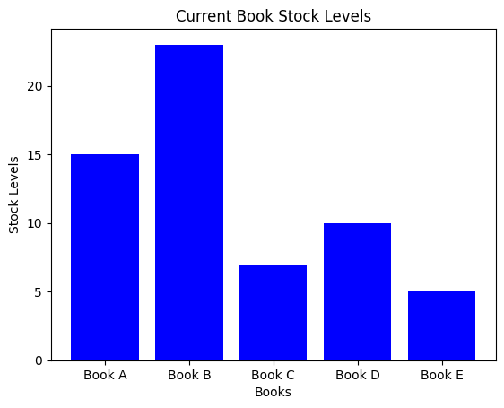
HI5030 Business Systems Analysis and Design
Tutorial Week 03
This bar chart is visualizing the current stock levels of different books, helping the purchasing manager to make informed decisions.

Slide 16
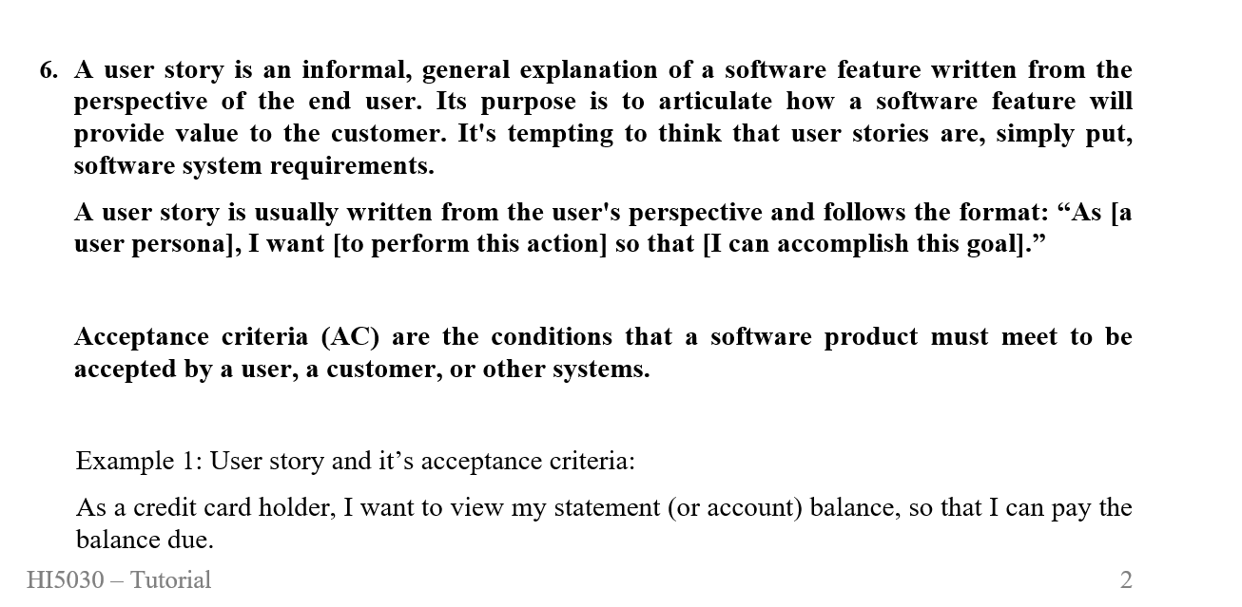
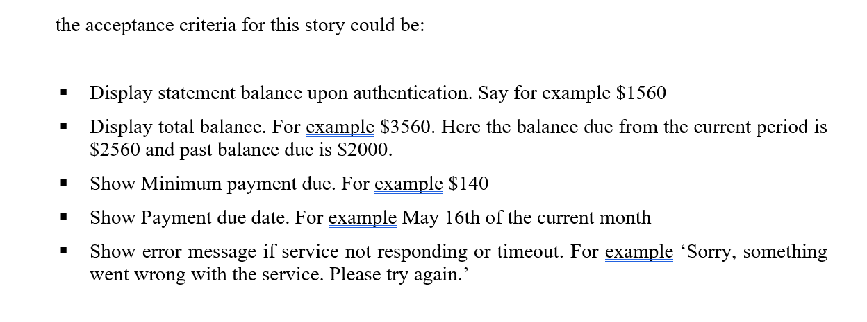
HI5030 Business Systems Analysis and Design
Tutorial Week 03

Slide 17
HI5030 Business Systems Analysis and Design
Tutorial Week 03
6. User Stories and Acceptance Criteria
a) Select any user of the WBS Case Study and write 2 user stories and the acceptance criteria.
User: Purchasing Manager
User Story 1:
Story: As a purchasing manager, I want to generate a report on book sales so that I can make informed purchasing decisions.
Acceptance Criteria:
Display a list of all books sold in the past month.
Include the quantity of each book sold.
Provide an option to export the report as a PDF or Excel file.
Display an error message if the report cannot be generated.
User Story 2:
Story: As a purchasing manager, I want to manage special orders so that I can ensure that customer requests are fulfilled efficiently.
Acceptance Criteria:
Allow entry of new special orders with customer details and book information.
Display the status of all current special orders.
Notify when a special order is ready for pickup.
Display an error message if the system cannot process the special order.

Slide 18
HI5030 Business Systems Analysis and Design
Tutorial Week 03
b) Write 2 user stories for the user Librarian and acceptance criteria.
User: Librarian
User Story 1:
Story: As a librarian, I want to check the availability of a book so that I can assist a patron in finding it.
Acceptance Criteria:
Search by title, author, or ISBN.
Display the current availability status of the book.
Show the location of the book within the library.
Display an error message if the book is not found in the system.
User Story 2:
Story: As a librarian, I want to manage overdue books so that I can ensure timely returns and maintain library inventory.
Acceptance Criteria:
List all overdue books with borrower details.
Send automated reminder emails to borrowers with overdue books.
Update the status when books are returned.
Display an error message if the system cannot send reminders or update statuses.

Slide 19
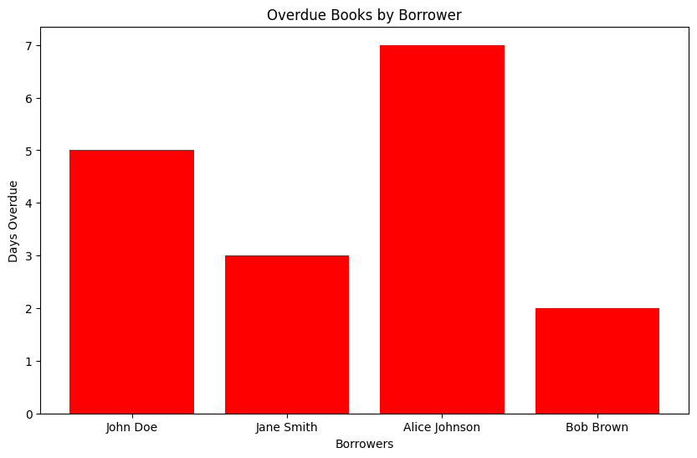
HI5030 Business Systems Analysis and Design
Tutorial Week 03
This bar chart is visualizing the number of days overdue for different borrowers, which can help librarians prioritize follow-up actions.

